Slide 1

베이즈 통계 심화스터디 week 4-2 Gibbs Sampling
배시예

Slide 2
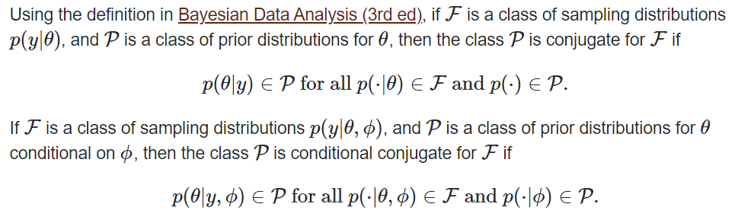
Conditionally Conjugate

Slide 3
Full Conditional Distribution
Conditioned on everything else
Posterior of conjugate가 되는 경우 -> 계산이 편리

Slide 4

Gibbs Sampler
Initialize $θ_{0}$, $φ_{0}$
For i=1, … , m, repeat:
1) using $φ_{i−1}$, draw $θ_{i} \sim$P($θ$| $φ_{i−1}$, y)
get ($θ_{i}$, $φ_{i−1}$)
2) using $θ_{i}$, draw $φ_{i}$ ~ P($φ$| $θ_{i}$, y)
get ($θ_{i}$, $φ_{i}$)

Slide 5
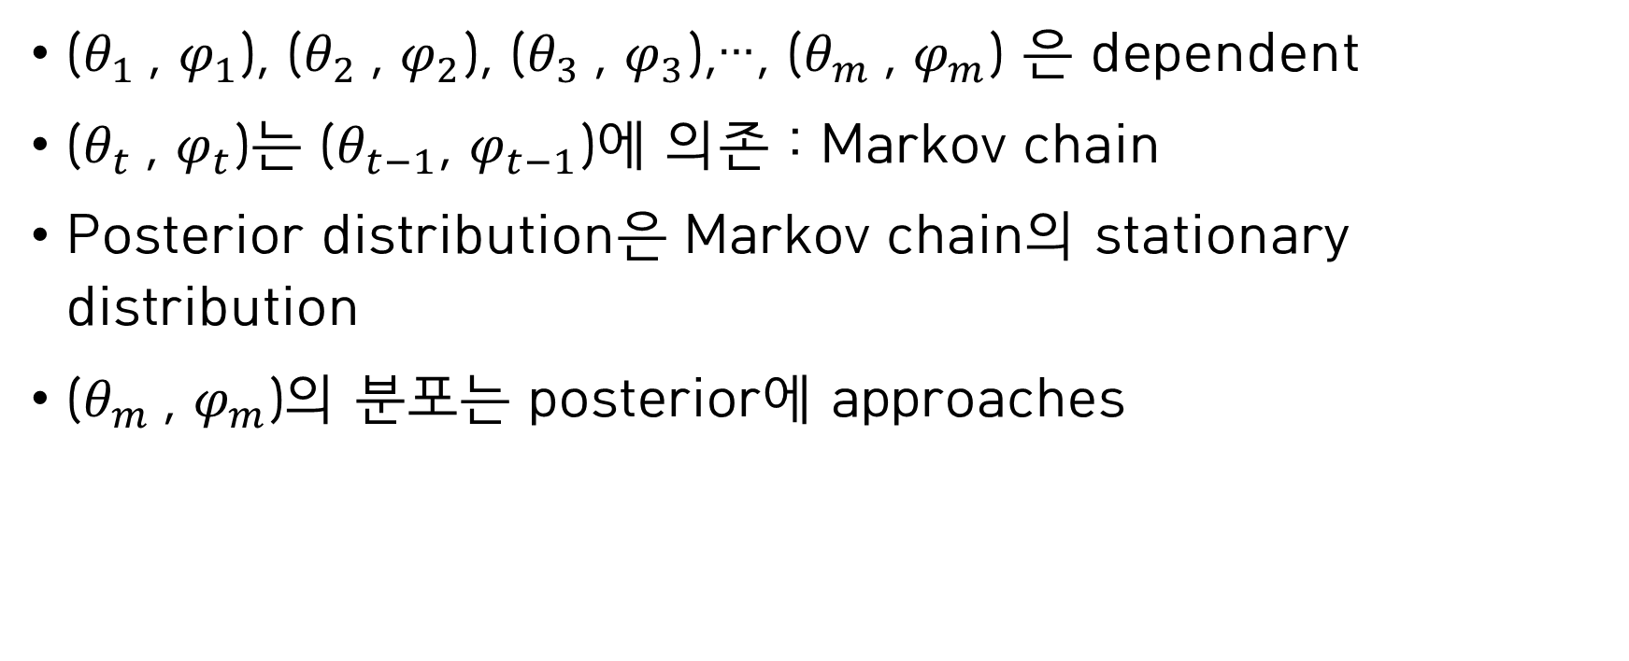
Gibbs Sampler
($θ_{1}$, $φ_{1}$), ($θ_{2}$, $φ_{2}$), ($θ_{3}$, $φ_{3}$),…, ($θ_{m}$, $φ_{m}$) 은 dependent
($θ_{t}$, $φ_{t}$)는 ($θ_{t−1}$, $φ_{t−1}$)에 의존 : Markov chain
Posterior distribution은 Markov chain의 stationary distribution
($θ_{m}$, $φ_{m}$)의 분포는 posterior에 approaches

Slide 6
Gibbs Sampler
Systematic Sweep Gibbs Sampler
Random Sweep Gibbs Sampler
Grouped Gibbs Sampler
Collapsed Gibbs Sampler

Slide 7
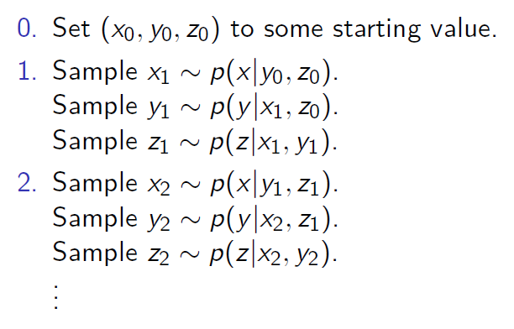
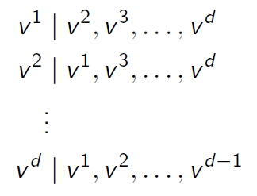
Gibbs Sampler

Slide 8
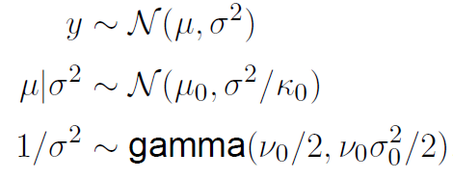
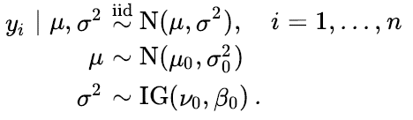
Example(Normal likelihood)
(참고) conjugate prior

Slide 9
Example(Normal likelihood)
Conjugate prior인 경우 Monte Carlo
(참고) conjugate prior

Slide 10
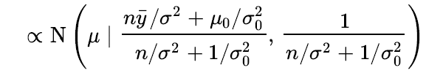
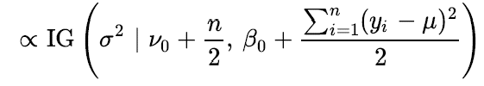
Example(Normal likelihood)

Slide 11
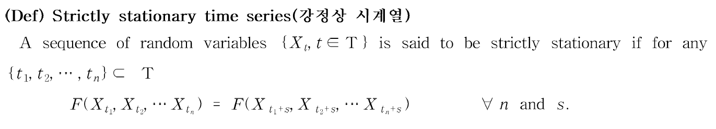
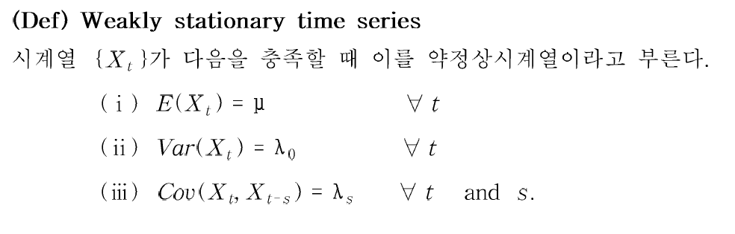
Stationarity

Slide 12
Autocorrelation
How much information is available in our Markov chain?
Monte Carlo effective sample size :
how many independent samples from the stationary distribution you would have to draw to have equivalent information in your Markov chain

Slide 13
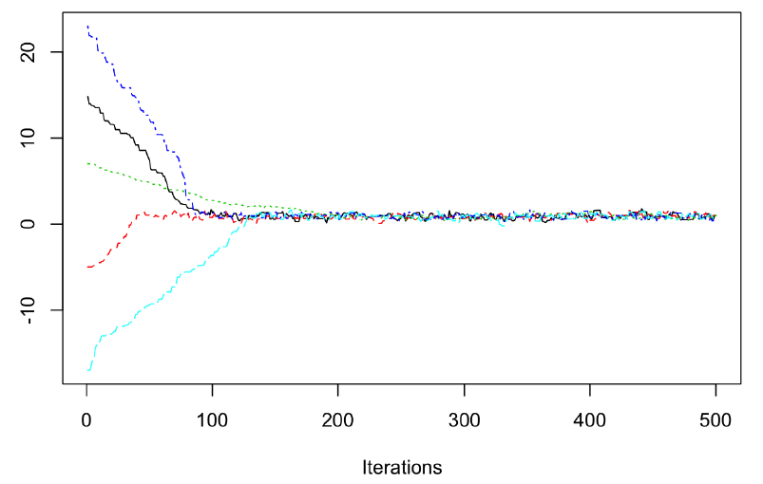
Convergence
Markov chain converged -> treat it as a Monte Carlo sample from the posterior distribution

